Slide 1
Models of Network Formation

Slide 2
14.1 Preferential attachment
Many networks are observed to have degree distributions that approximately follow power laws
  Examples are the Internet, the World Wide Web, citation networks, and some social networks and biological networks
A natural question is how might a network come to have such a distribution?
This question was first considered by Price in 1970s

Slide 3
Price was inspired by Herbert Simon who is an economist
  Simon noted the occurrence of power laws in a variety of (non-network) economic data
  Simon proposed an explanation for the wealth distribution based on the idea that people gain wealth at a rate proportional to how much they have already have
  Simon was able to show mathematically that “rich-get-richer”
  Price adapted Simon’s work to the network context
Price called it cumulative advantage
Barabasi and Albert used the name preferential attachment
  This name became commonly accepted in recent years

Slide 4
Price’s model of a citation network
Papers are published continually
New papers cite previously existing ones
Papers and citations form a directed citation network
  Papers are the vertices and citations are the directed edges
No papers ever disappear after they are published
  Vertices in this network are created but never destroyed
Let the average number of papers cited by a newly appearing paper be c

Slide 5
Price assumed that a newly appearing paper cites previous ones chosen at random with probability proportional to the number of citations those previous papers already have
  This crucial assumption is called preferential attachment
However, newly appearing papers have no citations. They cannot be cited by future papers if the preferential attachment rule is strictly applied
To avoid this hitch, Price proposed that the probability that a paper receives a new citation should be proportional to the number that it already has plus a positive constant a

Slide 6
One can interpret that a certain fraction of citations go to papers chosen uniformly at random without regard for how many citations they currently have
One also needs to specify an initial condition for the model
In the limit of large network size, the predictions of the model do not depend on the initial condition

Slide 7
Limitation of Price’s model
Obviously, Price’s model is only an approximation of real world citation networks
For example, the sizes of bibliographies vary from one field to another
  Paper quality
    Papers with large degrees likely to have good quality and they are cited more frequently
  Relevance of cited papers
    Old papers tend to have large degrees, but their topics may be out-dated and less likely be cited

Slide 8


Analysis of Price’s model
Let the in-degree of vertex i be denoted by q_{i}
Let p_{q}(n) be the fraction of vertices in the network that have in-degree q when the network contains n vertices
Suppose now a new paper is published
The probability that the citation is to a particular other vertex i is proportional to q_{i} + a
This probability must be normalized, ie

Slide 9

The expected number of new citations to vertex i upon appearance of our new paper is
There are n∙p_{q}(n) vertices with degree q in our network
Hence, the expected number of new citations to all vertices with degree q is

Slide 10

The expected number
of vertices of degree q
after a new paper is
published
The expected number of papers
that had degree q-1 before but
have degree q now
The expected number of
vertices of degree q
previously
The number of papers that
had degree q before, but
have degree q+1 now
This is called the master equation in the book
This analysis is called the mean field analysis

Slide 11

The previous equation holds for all values of q, except q=0
For q=0,

Slide 12
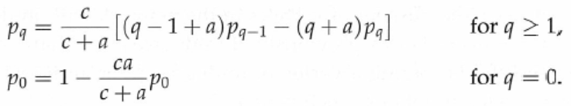
Steady state
Consider the limit of large network where n goes to infinity
Let p_{q} = p_{q}(∞)

Slide 13



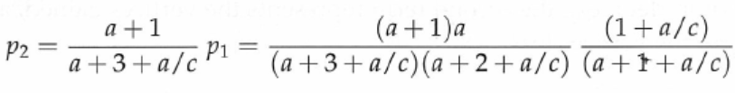
Solution

Slide 14


Slide 15



Gamma functions and their properties
Definition of gamma functions
Useful properties

Slide 16


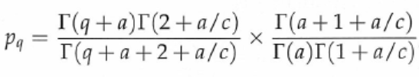

Euler’s beta function

Slide 17







Stirling’s approximation

Slide 18
14.2 The model of Barabasi and Albert
An undirected growing network model
Each new vertex makes connections to (exactly) c existing vertices, where c is an integer
Connections are made to vertices with probability precisely proportional to the vertices’ current degree
Denote the degree of vertex i by k_{i}
The smallest degree in the network is always k=c

Slide 19
Equivalence of the BA model and Price’s model
The BA model is equivalent to a special case of Price’s model
We give each edge added to the BA network a direction, running from the vertex just added to the previously existing vertex
  In this way we convert the BA network into a directed network in which each vertex has out-degree exactly c
The total degree k_{i} of a vertex in the sense of the original undirected network is the sum of the vertex’s in-degree and out-degree, ie. k_{i} = q_{i} + c

Slide 20

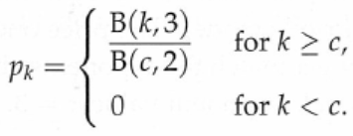
Given that the probability of an edge attaching to a vertex is proportional to k_{i} in the BA model, it is thus also proportional to q_{i}+c
  It would be the same as in Price’s model if we choose a=c
Thus,
Replacing q+c by k, we obtain

Slide 21


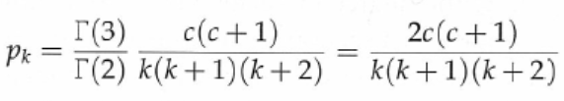

(14.39)
Eq. (14.39) was first derived by Krapivsky et al. and independently by Dorogovtsev et al.

Slide 22
The BA model is attractive for its simplicity
It has only one parameter
The degree distribution is simple and does not have special functions such as gamma and beta functions
However, its limitation is that it cannot match the exponent observed in real networks

Slide 23
14.3 Further properties of preferential attachment models
14.3.1 Degree distribution as a function of time of creation
In Price’s network, older vertices have more time to acquire links from other vertices and hence we expect that they would on average have higher in-degree
Let p_{q}(t, n) be the average fraction of vertices in the directed network that were created at time t and have in-degree q when the network has n vertices

Slide 24


A master equation for p_{q}(t,n)
Upon addition of a new vertex into the network, the expected number of new edges acquired by previously existing vertices with degree q is given by

Slide 25


Solution of the master equation
Let τ = t/n
Change p_{q}(t, n) to a density function π_{q}(τ, n) such that π_{q}(τ, n)dτ is the fraction of vertices that have in-degree q and fall in the interval from τ to τ+dτ
The number of vertices in the interval dτ is ndτ, which implies that

Slide 26
Note that τ is no longer constant for a given vertex
A vertex created at time t has rescaled time t/n when there are n vertices in the network, but t/(n+1) when there are n+1
The master equation becomes

Slide 27


Steady state
Consider the limit as n goes to infinity
Let ε = 1/n and
In the derivation of the last equation, terms of order ε² are dropped

Slide 28






As n goes to infinity and ε goes to zero, we have
The differential equation for q=0 is homogeneous and its solution is
A check
=p₀ in (14.9)

Slide 29


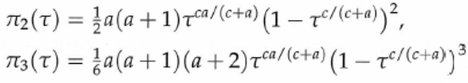
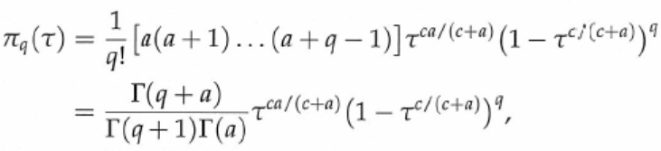
For q=1

Slide 30
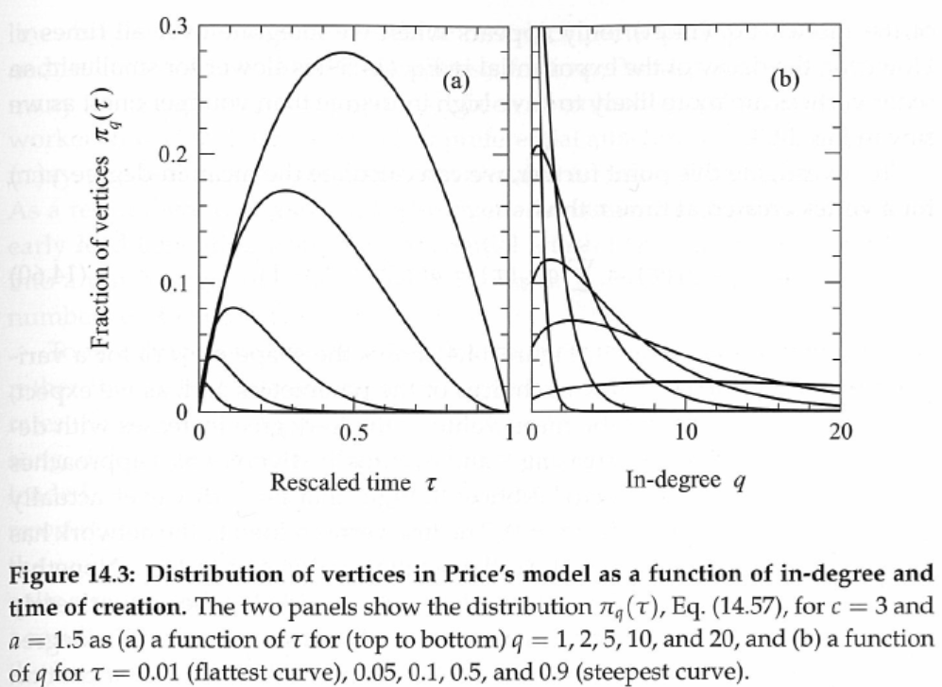

Slide 31


The degree distribution for a specific value of τ does not follow a power law

Slide 32

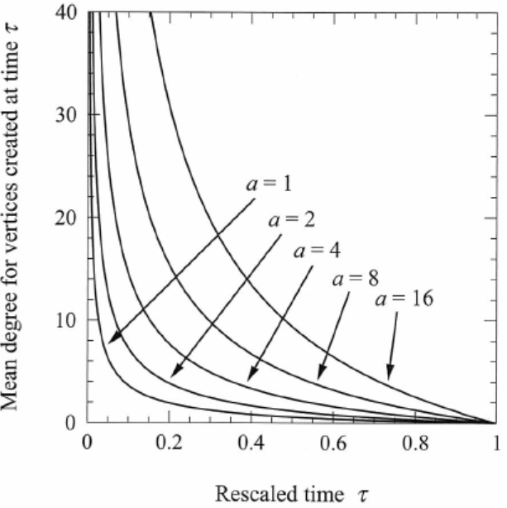
To demonstrate that older vertices are more likely to have high in-degree than younger ones, we calculate the mean in-degree for a vertex created at time τ

Slide 33

In-degree of a vertex varies with its age
It is interesting to ask how the expected in-degree of a vertex varies with it age after it enters the network
Let t be the time at which a vertex is added into the network
Let s be its age
s + t = n and

Slide 34
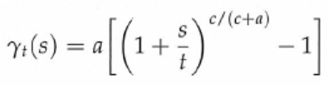


Substitute into
We obtain
If s « t, we have
If s » t, we have

Slide 35
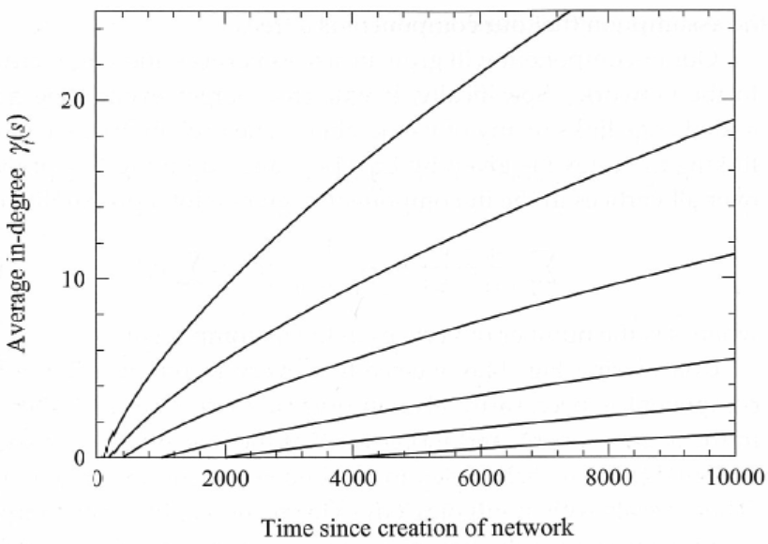

Slide 36
14.3.2 Sizes of in-components
Recall that the in-component of vertex i is the set of vertices from which i can be reached by following a directed path through the network
We will study the distribution of in-component sizes by a method similar to the one we have used for the degree distribution

Slide 37
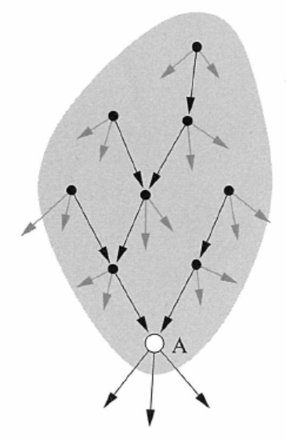
Structure of in-components
We assume that in-components are trees
This is accurate if the size s is much smaller than the network size n
It is possible that s becomes comparable with n in preferential attachment models

Slide 38
Analysis
The in-component will grow in size as vertices and edges are added into the network
Specifically, it will grow larger every time a newly added edge links to any of its members
The probability of a new edge linking to vertex i is given as
Summing up the above probability over all vertices in the in-component c gives a total probability

Slide 39



(14.66)
s=size of c
Every incoming edge to a vertex in the in-component is also an outgoing edge from a vertex in the in-component
There is exactly one outgoing edge from each vertex in the in-component, except for A itself
The total number of incoming edges is equal to the number of vertices in the in-component minus one, i.e.,
Thus, the probability of connection in (14.66) is
tree

Slide 40

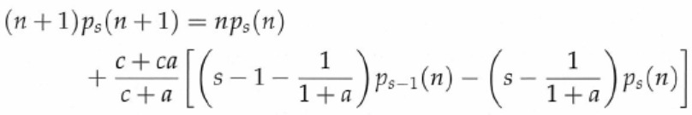

Let p_{s}(n) be the probability that a randomly chosen vertex has an in-component of size s when the network has n vertices (s « n)
The total number of in-components of size s receiving a new link upon the addition of a new vertex to the network is
The master equations are

Slide 41






Steady state
Consider the limit

Slide 42
For normal situation where c ≥ 1, we have 1 < β ≤ 2
This is puzzling, as power laws with β ≤ 2 have no finite mean
But, networks of finite size n must have a finite average in-component
The solution is that as s ceases to be much smaller than n, the analysis breaks down and the result is no longer correct (the tree assumption is no longer valid)

Slide 43
14.4 Extensions
14.4.1 Addition of extra edges
14.4.2 Removal of edges
14.4.3 Nonlinear preferential attachment
14.4.4 Vertices of varying quality or attractiveness

Slide 44
14.4.1 Addition of extra edges
Since the bibliography of a paper cannot be changed after the paper is published, the edges in a citation network are effectively frozen from the moment they are first created
It is not true for other networks such as WWW
In this section we consider a simple model in which edges are added but never taken away
This model is a generalization of the BA model by adding a second step: at each step some number w of extra edges are added to the network with both ends attaching to vertices chosen in proportional to degree

Slide 45



Analysis
First, there are n(c+w) edges in the network totally when the network size is n
There are c+2w new ends of edges for each new vertex added
The correctly normalized probability of attachment is
The sum in the denominator is
The number of vertices of degree k receiving a new edge, per vertex added, is
+

Slide 46

Master equations

Slide 47
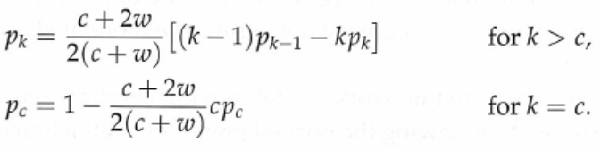


Steady state solution
For the special case of w=0, we recover the result of the BA model
For w>0, we get 2<α<3, which agrees with the values typically observed for degree distributions on the Web

Slide 48

14.4.2 Removal of edges
We assume that edges are removed from a network randomly and uniformly
Each edge has two ends
When an edge is deleted, both of its two ends vanish
The probability that one of those two ends is attached to vertex i is simply proportional to the total number of ends attached to i, which is equal to the degree k_{i}
The probability that vertex i loses an edge is thus

Slide 49
The uniform random deletion of edges is like a type of preferential attachment in reverse
Now consider a generalization of the BA model in which a second step is added: an average of v edges are deleted at random for each vertex added
We assume that c > v in order for the network to grow
The number of vertices of degree k gaining an edge per vertex added into the network is

Slide 50

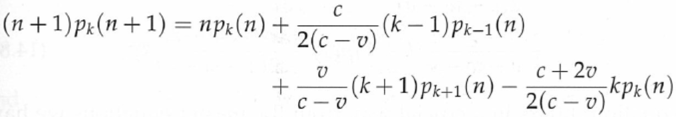
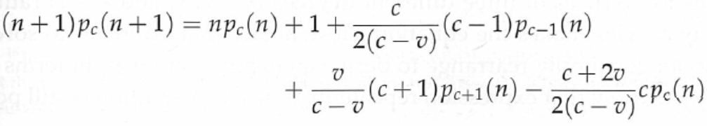
The number of vertices of degree k losing an edge per vertex added is
The master equations
k≠c
k=c

Slide 51
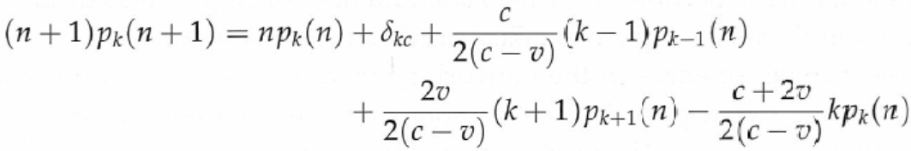
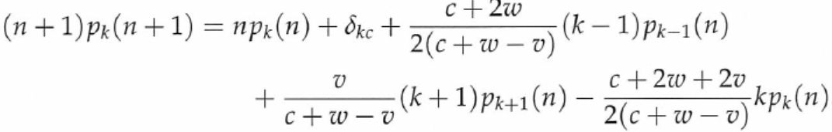
The above two cases can be combined
The above equation is not true for k=0
If k=0, the term proportional to k-1 vanishes
One can define p₋₁(n)=0 and the above equation becomes correct for all k≥0
One can generalize the above model by allowing extra addition of edges. Specifically, we can add w extra edges per vertex add. Then,
k>0

Slide 52
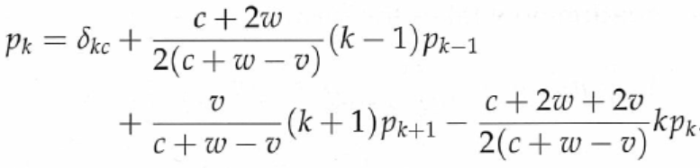
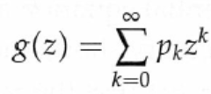
Steady state solution
This difference equation involves with degrees k-1, k, and k+1. From this point, the equation resembles that of an M/M/1 queue
Define

Slide 53
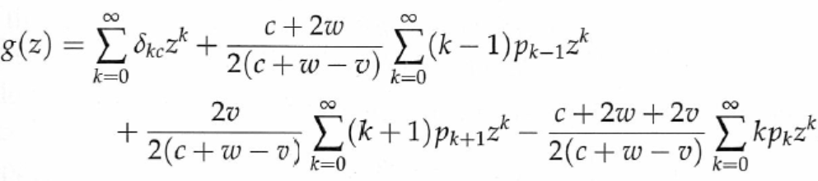
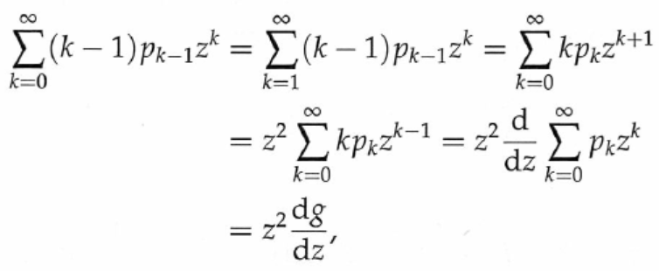
One needs to express the three sums in the above equation in terms of g(z)

Slide 54
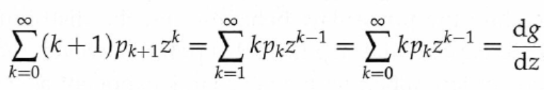
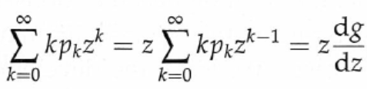
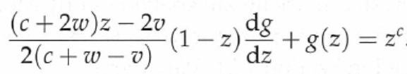
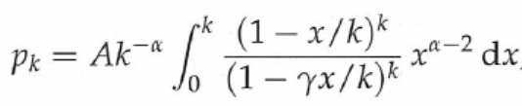
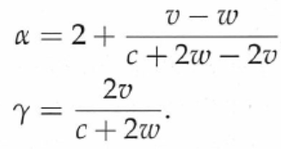
provided v-w<c/2

Slide 55
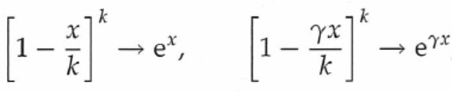


Slide 56

14.4.3 Nonlinear preferential attachment
So far, we have only considered models in which the probability of attaching to a vertex is linear
Statistical studies have shown that for some networks there was a roughly nonlinear attachment probability
We define an attachment kernel, denoted by a_{k}, which specifies the functional form of the attachment probability
  In the BA model, a_{k}=k
  For nonlinear model, a_{k}=k^{γ}
  The attachment probability is

Slide 57
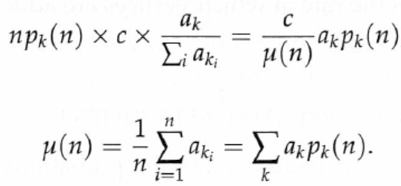

The expected number of vertices of degree k receiving a new edge when a single new vertex is added into the network is
The master equation

Slide 58

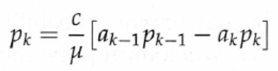

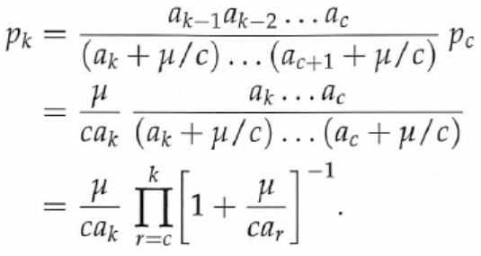

Steady state
Solution

Slide 59
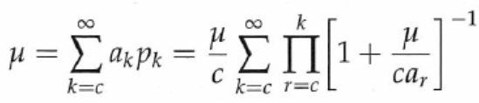
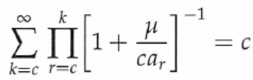
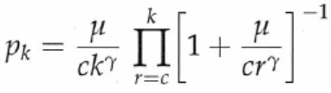
The above equation is unsolvable in closed form
Even without knowing μ, we can still find the overall functional form of p_{k}, which answers many interesting questions
Putting a_{k}=k^{γ} gives

Slide 60
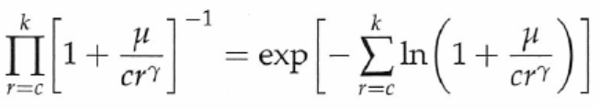
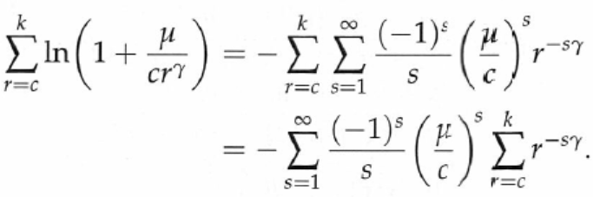
The power-law form is sensitive to the precise shape of the attachment probability
To see this, write
Expanding the logarithm as a Taylor series
Approximate the sum by an integral using the trapezoidal rule

Slide 61
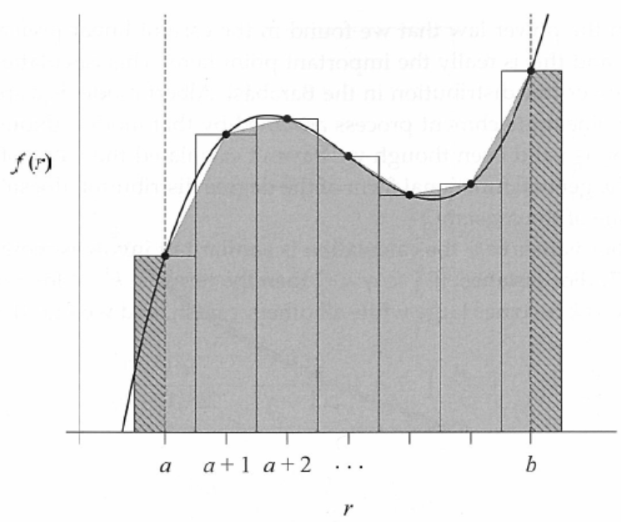
Trapezoidal rule

Slide 62
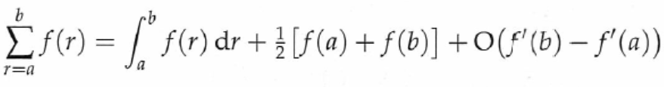
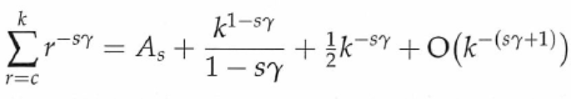
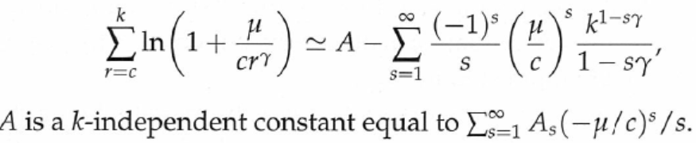
For large k, we have
In the limit that k goes to infinity, all terms in k^{1-sγ} where 1-sγ < 0 also vanish

Slide 63
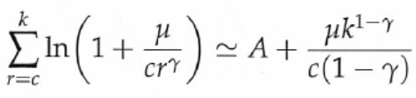
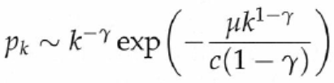
For ½ < γ < 1, only the term for s=1 grows as k increases, all other vanishing, and
Now combining the equations in red, blue and green boxes, we have
This is called stretched exponentials
½<γ<1

Slide 64
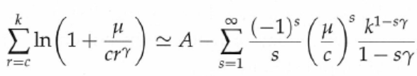
For other values of γ, the calculation is similar but the following equation involves more terms
We omit the details

Slide 65
14.4.4 Vertices of varying quality of attractiveness
So far we have assumed that all vertices of a given degree are equally likely to gain a new edge
  For example, all papers that have never been cited before are equally likely to get new citations
  All websites that no one has linked to yet are equally likely to receive links
In real world, there are huge differences in the perceived importance and quality of scientific papers or websites that mean some are far more likely to gain edges than others
  For example, a directory or an encyclopedia website is more likely to gain edges than personal home pages

Slide 66
Bianconi and Barabasi [42,43] allow effects of varying node quality – or fitness as they call it
As we will see, the power-law behavior of traditional models disappears once vertex fitness enters the picture, although the distribution for vertices of a given fitness still follows a power law
Each vertex i has a fitness η_{i} that is assigned at the moment of the vertex’s creation and never changed thereafter
The fitnesses are real numbers with values drawn from some distribution ρ(η), so that the probability of a value falling between η and η+dη is ρ(η)dη

Slide 67




Each of the c new edges added with each new vertex attaches to an existing vertex with probability proportional to an attachment kernel a_{k}(η)
  Bianconi and Barabasi examined the special case where a_{k}(η)=ηk
  Krapivsky and Redner [188] studied a general model
The master equation in steady state
k>c

Slide 68

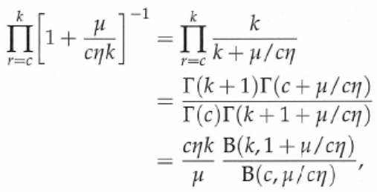

Solution of the master equation
Consider a special case where a_{k}(η)=ηk
r
r
r

Slide 69

This implies that the distribution of the degrees of vertices with a particular fitness has a power law tail
However, the overall degree distribution for the entire network may or may not have a power law tail, depending on ρ(η)
  If ρ(η) is very sharp and peaked at a certain value, the model reduces to the original BA model. In this case, the degree distribution has a power law tail
  If ρ(η) is very broadly distributed, the degree distribution will be a sum over power laws with a wide range of different exponents. In this case, the degree distribution does not follow a power law

Slide 70
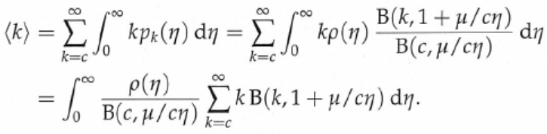
More analysis
Let us calculate the mean degree of a vertex
  This may seem a pointless exercise, since the mean degree must be 2c (since exactly c edges are added for every new vertex)
The average degree is

Slide 71


The sum can be simplified by making use of the integral form of the Euler’s beta functions
This result only works if η < μ/c
If η ≥ μ/c, the sum diverges and the average degree is infinite
  But this is impossible, because the mean degree is always 2c
To avoid the divergence we impose the restriction that ρ(η)=0 for η≥η₀ where η₀ is a constant in the range 0≤η₀<μ/c

Slide 72
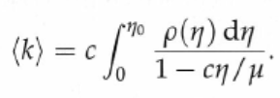

Combining the equations in the red and blue boxes, we obtain
Since the mean degree is 2c, we have
This integral is a monotonically decreasing function of μ: it takes its smallest value of 1 when μ goes to infinity, and its largest value when μ approaches cη₀
If the largest value is smaller than 2, then the above equation does not have a solution, meaning that no value of η such that (4.133) gives the correct mean degree
(4.133)

Slide 73
A puzzle
How can it be that our solution does not give the correct value for the average degree?
Have we made a mistake somewhere?
What does the network actually do in this regime?

Slide 74
Answer
The answer to this conundrum is a subtle and interesting one
There are some behaviors of the vertex degrees in a growing network that cannot be captured by a simple probability distribution p_{k}
In particular, if there are a fixed, finite number of vertices in the network with degrees that scale in proportion to the size n of the network, those vertices do not appear in the degree distribution: because there are only a fixed number of them they constitute a fraction 1/n of the network hence contribute zero for large n

Slide 75
Condensation and condensate
Nonetheless, they make a non-zero contribution to the average degree of the network in the limit of large n and hence must be taken into account in the calculation of <k>
Bianconi and Barbarasi referred to the appearance of such vertices in the network as “condensation” by analogy with similar behaviors seen in low temperature physics, and to the vertices themselves as a condensate.
For some choices of ρ(η) this kind of condensation does indeed occur and a condensate of “superhubs” with very high degree forms in the network

Slide 76
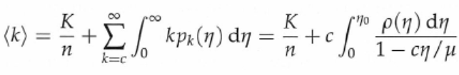

Suppose that we are in such a regime and let the sum of the degrees of the vertices in the condensate as K
Then
No matter what the value of the integral, it is always possible to achieve <k>=2c by making K sufficiently large
The appropriate value for K is
The largest value of the integral is achieved when μ approaches cη_{0,} which means that

Slide 77
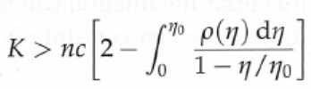


If the value of the above integral is less than 2, then we require that K scales with the size n as we have hypothesized
As an example, ρ(η) = A(η₀ − η)^{τ}, where τ is positive and A is normalization constant
The integral is
If τ < 1, the above inequality imposes no constraint on K. If τ > 1, K must be linear with n

Slide 78
Thus, depending on our choice for the distribution of the fitnesses, the network can show two different behaviors
In one case, the distributions of the degrees of vertices with any given fitness follow a power law with a fitness dependent exponent
  In this case, no vertices in the network are special or distinguished by any particular behavior
In the other case, a condensate forms consisting of one or more superhubs, which connect to a non-zero fraction of all other vertices
  None of the remaining non-condensate vertices show any special behavior, however; they still have power law degree distributions for each value of fitnesses

Slide 79

We still need to find the value of μ to evaluate
This needs the exact form of the condensate
In the literature, it is assumed that the condensate consists of just a single vertex of degree K at or close to the maximum fitness η₀
From (4.126), which is
we have

Slide 80

From (14.129) and (14.132), we have
From the two equations in red boxes we can solve K and μ for a given ρ(η)

Slide 81
Discussion
In principle the condensate could contain more than 1 vertex
It could even contain a growing number of vertices provided the number grows slower than linearly with n
  In this case, the superhubs have degrees that scale sublinearly with n
It is not known how to predict which of these behaviors will happen for a given choice of ρ(η)

Slide 82
An exact prediction may not even be possible
  Computer simulations of the model appear to indicate that the exact nature of the condensate – how many vertices it contains and how their degrees grow with n – is not deterministic but depends on the details of fluctuations taking place in the early growth of the network
  If one performs repeated computer simulations with the same choice of ρ(η) , the macroscopic behavior of the condensate varies from one run to another

Slide 83
Unbounded fitness distribution
The value of the highest fitness may change from time to time, which also changes the value of μ via Eq. (14.126), ie
However, the changes in the highest fitness become rarer and rarer as time goes by so that asymptotically the behavior of the system is the same in the bounded and unbounded cases for arbitrarily long time

Slide 84
14.5 Vertex copying models
Preferential attachment is not the only known mechanism that generates power law degree distributions
Some authors tend to cite papers that appear in the reference lists of the papers that they have read
Kleinberg et al. have proposed a network formation model based this idea
  People simply copied the entire bibliography of a paper to create the new bibliography of their own paper
  This is interesting but clearly not practical

Slide 85
Assume that only some fraction of the entries in the old bibliography are copied
The remainder of the new bibliography is filled out with references to other papers
  The other papers can be selected uniformly from the network

Slide 86
The model
Vertices are added into the network one by one
Each new vertex added has the same out-degree c
For each new vertex we choose uniformly randomly a previous vertex and go one by one through the c entries in the bibliography of that previous vertex
For each entry we either
  (a) with probability γ < 1 copy the entry to the bibliography of the new vertex, or
  (b) with probability 1-γ add to the new paper a citation to a previous paper selected uniformly and randomly

Slide 87
Thus, on average, γc of the entries are copied from an old vertex and the remainder are chosen at random
  Imperfect copy
The probability for vertex i to receive a new incoming edge is
  The newly added vertex copy connection from a vertex that already points to vertex i
  i could be one of the vertices chosen at random to receive a new edge
Suppose that a particular vertex happens to have a link to vertex i
  If i has incoming degree q_{i}, the chance that any of the q_{i} vertices get selected is q_{i}/n
  Thus, the probability is γq_{i}/n

Slide 88


There are, on average, (1−γ)c existing vertices that are selected uniformly and randomly
Since each existing vertex can be selected with probability 1/n, the probability that vertex i is selected is (1−γ)c/n
The total probability that vertex i gets a new edge is
The probability that a vertex with degree q is attached is

Slide 89




Equivalence of the master equation to that of Price’s model
Define
We convert the master equation to that identical to Price’s model
The exponent of the power-law degree distribution

Slide 90
Discussion
For citation networks, one may not be able to firmly say that preferential attachment or vertex copying is the mechanism that creates the network
One may examine a real-life network to see if there appear to be pairs of vertices whose outgoing connections are approximate copies of one another
  In real citation networks there are many such pairs
  They correspond to papers on similar topics; there is no need to assume that one of them copied from the other

Slide 91
However, vertex copying seems to a plausible candidate to explain the structure of many biological networks
  Protein interaction network

